Slide 2
Lesson 3: Object Oriented Design (10hrs)
Writing contracts: Describing and Elaborating Use Cases
Collaboration Diagram and Sequence Diagram
Objects and Patterns (information expert, creator, low coupling, high cohesion, controller)
Determining Visibility
Class Diagram

Slide 3
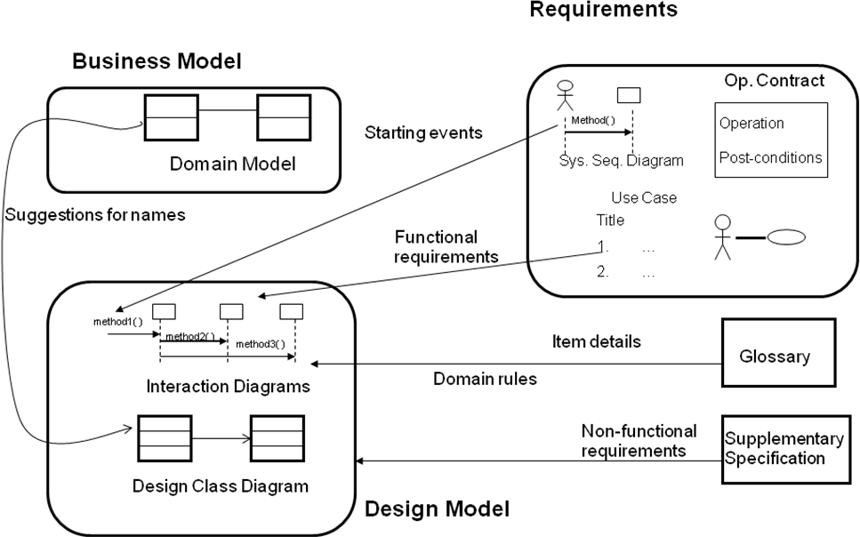
OOD

Slide 4
Object Oriented Design Outputs
INTERACTION DIAGRAM
Serves as an Extension of the System Sequence Diagram
Add specific objects to the System Sequence Diagram to handle system events.
Sequence diagrams depict parallel vertical lines representing processes or objects and horizontal arrows indicating the order of exchanged messages.
There are two common types:
Communication diagrams
Sequence diagrams

Slide 5
Sequence Diagram
Sequence diagram highlights more the temporal aspect of the system i.e. it shows object interaction in a timely manner.
Sequence diagram is an interaction diagram that shows messages exchanged or interactions between objects in the system.
It mainly emphasizes the time ordering of messages between objects.
It is used to illustrate the dynamic view of the system.

Slide 6
Sequence Diagram
:ClassAInstance
:ClassBInstance
message1()
message2()
message3()
message4()

Slide 7
Notations: Objects or Participants
The sequence diagram comprises a collection of participants or objects.
Participants are system parts that interact with each other during the sequence diagram.
The participants interact with each other by sending and receiving messages.
The name of the object and the class is underlined.
Class Instance Named Instance
Sale
:Sale
S1: Sale

Slide 8
Notations: Messages
Message between objects is represented with a message expression and a horizontal line with small arrow indicating the direction of the message.
Only one message can flow along one line.
:ClassAInstance
:ClassBInstance
message1()
message2()

Slide 9
Notations: Reply
Using a reply (or return) message line at the end of an activation bar.
:ClassAInstance
:ClassBInstance
message1()
message2
message3

Slide 10
Notations: Creation of Instance
Newly created objects are placed at their creation height.
Create message used to denote the creation of the instance.
:ClassAInstance
:ClassBInstance
message1
message2
create()
:ClassCInstance
msg4()

Slide 11
Notations: Deletion of Instance
<<destroy>> message with the large x symbol used to denote the destroy of the instance.
:ClassAInstance
:ClassBInstance
message1
message2
create()
:ClassCInstance
msg4()
<<destroy>>

Slide 12
Notations: Diagram Frames
Frame Operator | Meaning
alt | Alternative fragment for mutual exclusion conditional logic expressed in the guards.
loop | Loop fragment while guard is true. Can also write loop(n) to indicate looping n times.
opt | Optional fragment that executes if guard is true.
par | Parallel fragments that execute in parallel.
region | Critical reason within which only one thread can run.

Slide 13
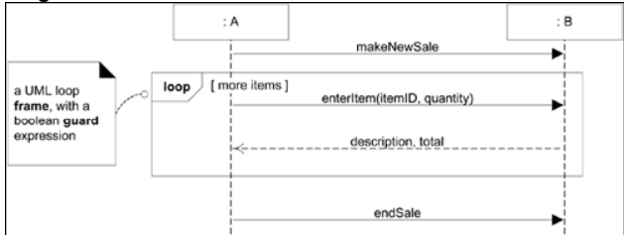
Iteration
A loop frame is placed around the message.
The message is iterated till the clause evaluates to true.

Slide 14
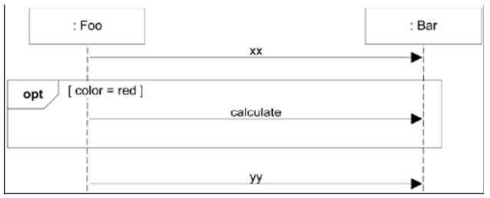
Conditional Messages
Conditional clause in square brackets, like an iteration clause.
The message is only sent if the clause evaluates to true.

Slide 15
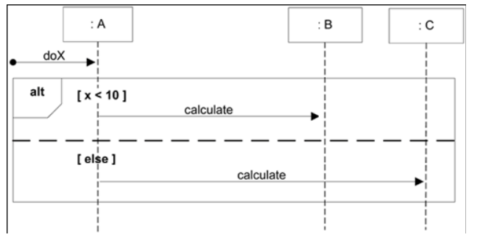
Mutually Exclusive Conditional Paths
An ALT frame is placed around the mutually exclusive alternatives.

Slide 16
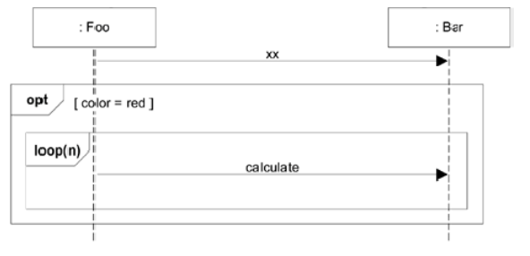
Nesting of Frames

Slide 17
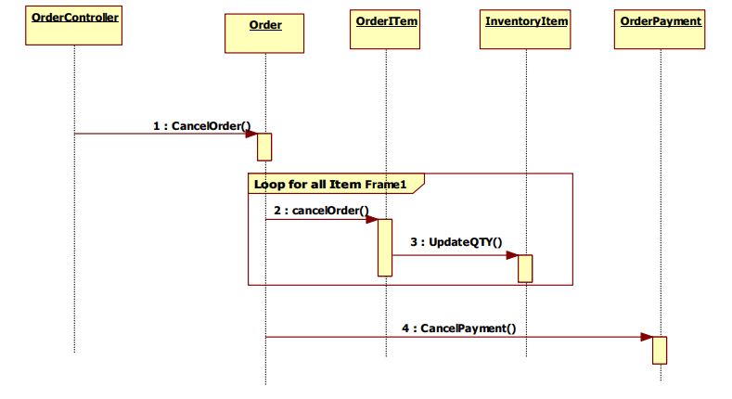
SD for Cancel Order

Slide 18
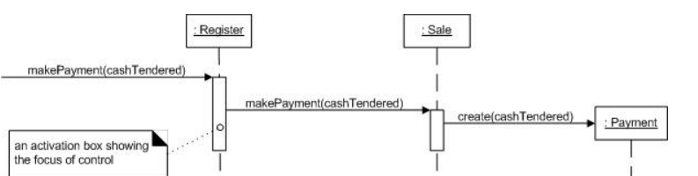
SD
Fig. Sequence diagram of makePayment Use Case
The message makePayment is sent to an instance of a Register. The sender is not identified.
The Register instance sends the makePayment message to a Sale instance.
The Sale instance creates an instance of a Payment.

Slide 19
System Sequence Diagram
Sequence Diagram
Purpose:
Capture high-level interactions between external actors and the system for a specific use case.
Focus:
Emphasizes the external perspective, highlighting the sequence of messages exchanged between actors and the system.
Captures the essential functionality required by stakeholders.
Purpose:
Refine and detail the interactions between objects or components identified during analysis.
Focus:
Expands on the internal details, showing the collaboration and communication between objects or components.
Includes object interactions, method calls, and the flow of control within the system.

Slide 20
System Sequence Diagram
Sequence Diagram
Abstraction:
Relatively high-level abstraction.
Omits internal details of how the system processes messages.
Participants:
External actors and the system.
Typically shows only the primary actors and the system boundary.
Abstraction:
More detailed and includes information about internal operations.
Specifies the behavior of individual objects and their collaborations.
Participants:
Objects or components within the system.
Represents the system’s internal structure, including the objects collaborating to achieve the use case.

Slide 21
System Sequence Diagram
Sequence Diagram
Messages:
Focuses on high-level operations initiated by actors.
Typically shows only the essential messages for the use case.
Granularity:
Coarse-grained, providing an overview of the system's response to external events.
Messages:
Specifies detailed method calls, interactions, and data exchanges between objects.
Represents the flow of control and communication among objects or components.
Granularity:
Fine-grained, capturing the detailed interactions and operations within the system.

Slide 22
System Sequence Diagram
Sequence Diagram
Use:
Guides requirements analysis and specification.
Helps stakeholders understand the essential interactions without delving into internal details.
Timeline:
Focuses on the sequence of events and messages between actors and the system.
Use:
Guides the development team during the design and implementation phases.
Provides a blueprint for the internal structure and interactions of the system.
Timeline:
Specifies the sequence and timing of method calls and interactions between objects.

Slide 23
Object Design Techniques
Collaboration and Interaction Design:
Principle:
Objects collaborate to achieve system goals.
Technique:
Identify collaborations between objects.
Design interactions and messages exchanged between objects to achieve specific tasks.
Use of Design Patterns:
Principle:
Reusable solutions to common design problems.
Technique:
Apply established design patterns to solve recurring design challenges.
Enhances maintainability, flexibility, and scalability.

Slide 25
PREVIEW FOR LECTURE 11
INTERACTION DIAGRAM PRACTICAL

